Slide 1
LoopedIn
Medium-Fi Prototype

Slide 2
Value Proposition/Mission Statement
“Fostering teamwork between students, parents, and teachers”
Mission Statement: to help encourage awareness, motivation, and communication between students, parents, and teachers by making them a team with the student at the center

Slide 3
3 Tasks (Parent, Student, and Teacher)
Simple Task - Mark an assignment complete
Medium Task - Change chosen reward to field trip
Complex Task - Create an assignment

Slide 4
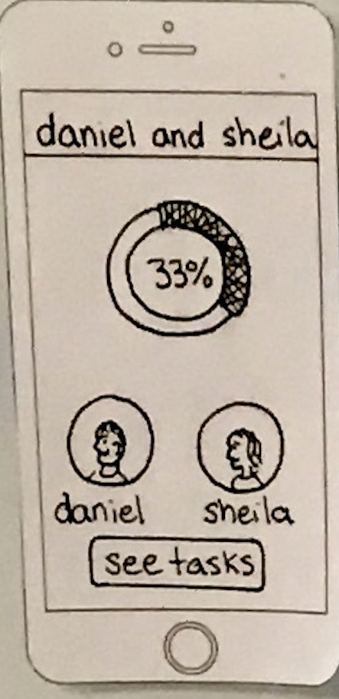
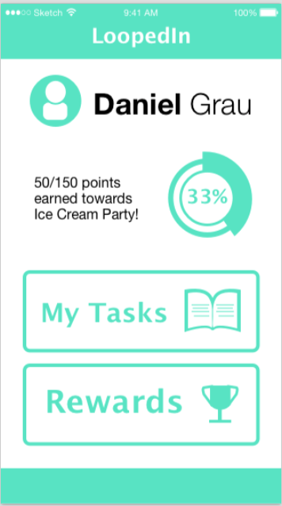
Revisions: Student View
Changed homepage, icons were unclear
No parent tasks displayed

Slide 5
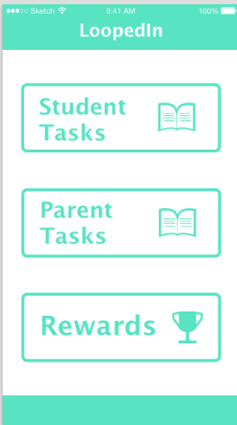
Revisions: Parent View
Changed homepage, icons were unclear
Student and parent tasks displayed

Slide 6
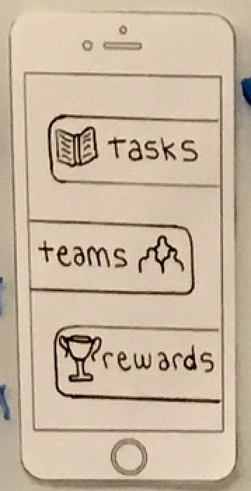
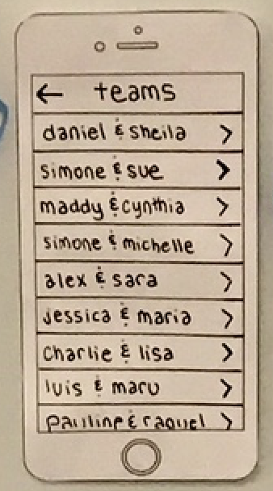
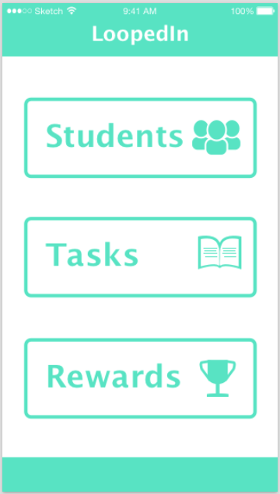
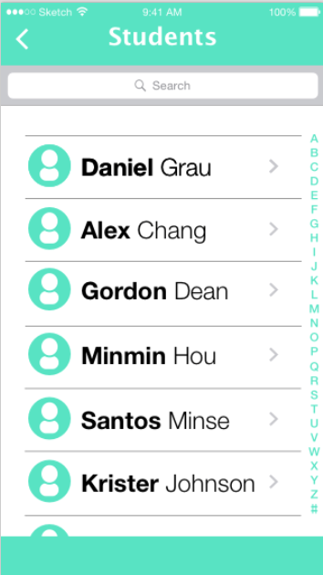
Revisions: Teacher View
Changed from “teams” to students

Slide 7
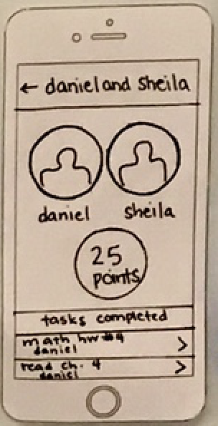
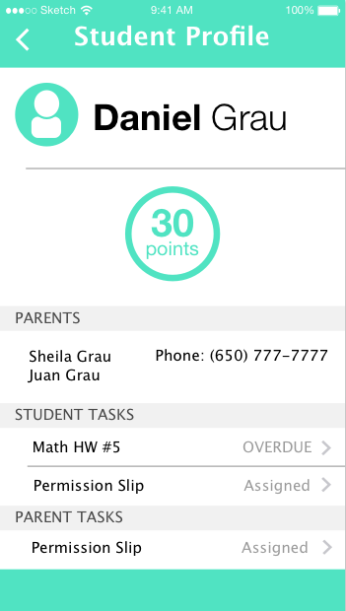
Revisions: Teacher View
Student and parent tasks more clearly displayed

Slide 8
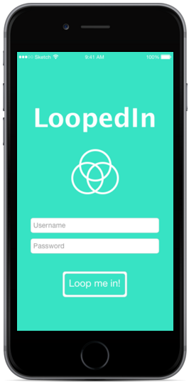
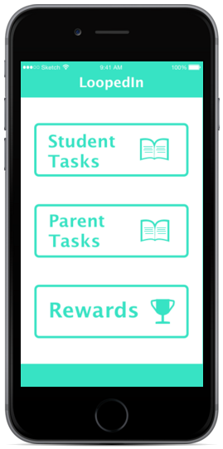
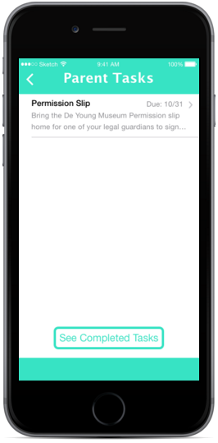
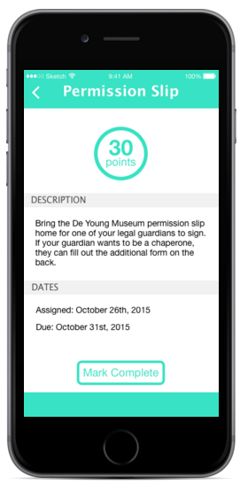
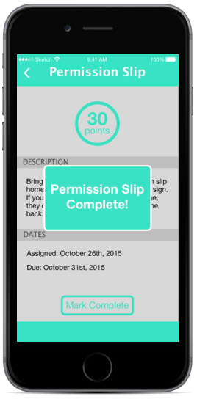
Task Flow 1: Mark an assignment as complete
Parent View

Slide 9
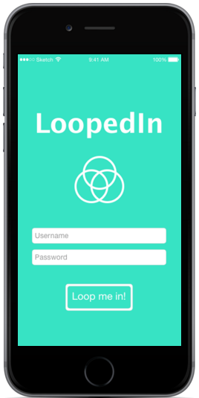
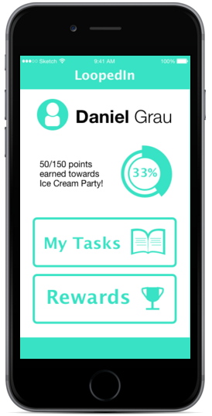
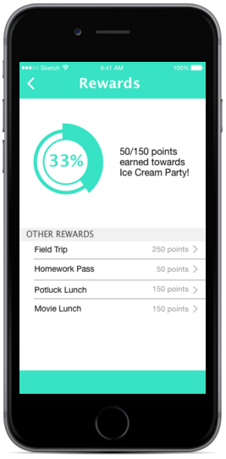
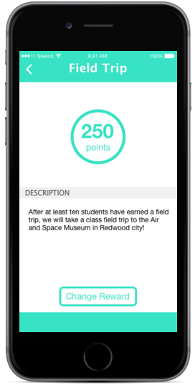
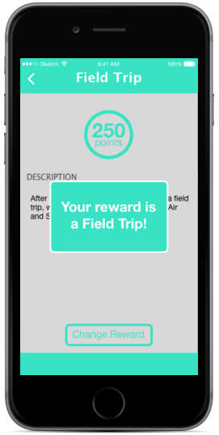
Task Flow 2: Change chosen reward to field trip
Student View

Slide 10
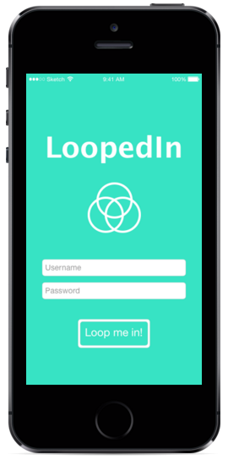
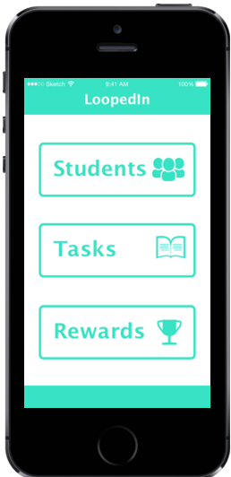
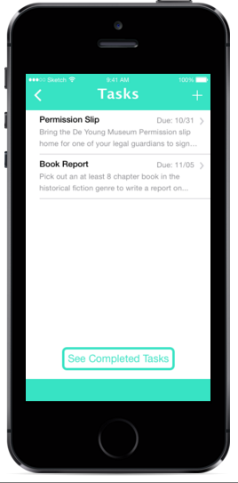
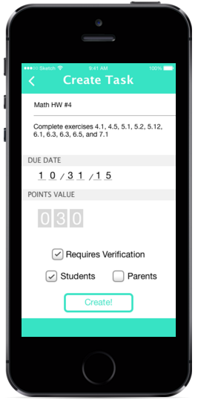
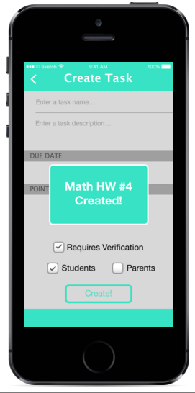
Task Flow 3: Create an assignment
Teacher View

Slide 11
Prototype Overview
Tools: Marvel and Sketch
Limitations and Tradeoffs
Wizard of Oz Techniques

Slide 12
Try it out!
Parent: https://marvelapp.com/1d951b9
Student: https://marvelapp.com/12615j4
Teacher: https://marvelapp.com/ga89ab

